Slide 1


A Framework for Improving Data Integration with Linked Data
Ahmad Assaf †
Supervised by:
Aline Senart† and Raphaël Troncy‡
†SAP Research, SAP Research France SAS
‡EURECOM, Sophia Antipolis - France
Dec 14, 2012
Public

Slide 2
Background
MSc Advanced Software Engineering – University of St. Andrews (UK)
Research interests: Collective Intelligence, Data Integration & Visualization
Technical Background: Web Development technologies
RUBIX
remix
Panorama
BI
RTI
Internship Oct 11- April 12
PhD Start May 12
RUBIX: Two-men team (main contributor)
remix: Collaboration between BI teams in Sophia and Dresden (UI\UX)
Panorama: Collaboration between RTI Sophia and RTI Paris

Slide 3
Earlier Research Direction An Interaction Framework for Business Intelligence
Interactions, Support for Mobility
Interactions, Support for Mobility
Data Visualization
Users' End Goal
Data Selection
Working with Large Data Sets
Data Manipulation
Data Analysis
Working with External Data Sources using agreed-upon semantics
Presenting Recommendations, Suggestions and Feedback
Simplicity
Data Exploration
Users Interactions' Tracing

Slide 4
Projects
RUBIX
remix
Panorama

Slide 5






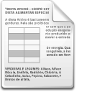




RUBIX - Problem Definition Linking External Data
Decision Making Process
Enterprise Data
Social Media Feeds
Business Intelligence Analysis
Sensor Data
Governmental Data
ERP - -
PRM
CRM
Distributed sources with heterogeneous data formats and terminologies
Complex data models
Different storage models
Noisiness (duplications, inconsistencies)
→ Need to find mappings between these internal and external complex data structures (schema matching)
Notes:
Companies have traditionally performed business analysis based on transactional data stored in legacy relational databases. The enterprise data available for decision makers was typically relationship management or enterprise resource planning data [2]. However social media feeds, weblogs, sensor data, or data published by governments or international organizations are nowadays becoming increasingly available [3].
Model/representation heterogeneity → differences in model (database, ontology) or their representation (relational, RDF . )

Slide 6
RUBIX - Proposal
Goal: Allow business users to semi-automatically combine potentially noisy data residing in heterogeneous silos
Proposal
Implementation
Provide a novel framework enabling schema matching of internal and external sources
Develop several matching algorithms to increase accuracy
Leverage Linked Data to enrich the cells
Compare schemas on several bases:
Column global type and name
Cells` rich types retrieved from Linked Data
Google Refine: A tool designed to process, clean and enrich large amounts of data with existing knowledge bases
Auto Mapping Core: A tool designed by SAP Research, enabling the developer to combine several matching algorithms
Freebase: An open repository of structured data
Notes:
Google Refine targets one data set at a time (no possibility for data sets mash-up)
Google Refine already supports reconciliation with Freebase but requires confirmation from the user.

Slide 7
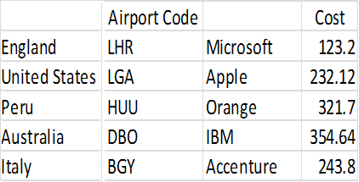
RUBIX - Experiments
Different languages (header name and cell values)
Abbreviations
Codes (IATA, NASDAQ)
Empty column headers
Notes:
Workflow

Slide 8
RUBIX - Experiments Results
AMC by default runs a set of String matching algorithms between columns` headers
Extra plugins (matchers) can be configured and added
The results of different matchers are combined using different methods, for our experiments the default “average method” is used
The results of AMC default matching algorithms:

Slide 9
RUBIX - Experiments Results
AMC’s default set + Cosine Similarity
AMC’s default set + Cosine Similarity + PPMCC method
AMC’s default set + Cosine Similarity + PPMCC method + Spearman’s

Slide 10
RUBIX - Publications
Ahmad Assaf, Eldad Louw, Aline Senart, Corentin Follenfant, Raphael Troncy, David Trastour, RUBIX: A Framework for Improving Data Integration with Linked Data, to be published in ICP Series of the ACM Digital Library.
Ahmad Assaf, Eldad Louw, Aline Senart, Corentin Follenfant, Raphael Troncy, David Trastour, Improving Schema Matching with Linked Data, In Proceedings of the 1st International Workshop on Open Data (WOD), Nantes, France, May 2012.

Slide 11
Projects
RUBIX
remix
Panorama

Slide 12

remix
is a self-service BI tool that enables non-technical business users to compose existing BI artifacts with new structured internal and external data sources.
It helps business users intuitively and quickly build insightful reports.
It enables the composition of existing BI artifacts with new data from the enterprise and from external sources.
Recommends the best course of action by leveraging content and interaction traces

Slide 13
remix
Demo

Slide 14
Data quality
Data quality involves data management, modeling, analysis, storage and presentation
It is an important issue for data driven applications which should be deeply investigated and understood in order to ensure the data is fit to be combined and used to infer better business decisions
Data quality is subjective and cannot be assessed easily, the actual value of data is mainly realized when it is used
Studies found out that most data quality problems are in fact “data misinterpretations” or problems with the data semantics
→ With the rise of Semantic Web, new data quality principles should be identified
Notes:
So, how to properly integrate external data with internal ones? A certain level of quality is clearly necessary. Data Quality involves data management, modeling, analysis storage and presentation since it ensures that the data is fit to be combined and used to infer better business decisions. Quality is important in every data driven application; but it is a subjective measure, as the saying goes “beauty is in the eye of the beholder”. Quality is mainly realized when the data is used, it can be defined as fit for purpose of use !! But data can have multiple uses, and we want a generic framework to assess its quality.
Several studies have found out that most data quality problems are in fact “data misinterpretations” or problems in the data semantics, for example if I am querying for a revenue per year value, different sources might have different presentations for the term “year”, it can be a fiscal or calendar year or even the last 12 months.
By now we identified that there is a need for new Data quality principles in terms of measures and classes.

Slide 15
Our Proposal
Data Quality Principle | Attribute
Quality of Data Sources | Accessibility
 | Authority & Sustainability
 | License
 | Trustworthiness & verifiability
 | Performance
Quality of raw data | Accuracy | Referential correspondence
 |  | Cleanness
 |  | Consistency
 | Comprehensibility
 | Completeness
 | Typing
 | Provenance
 | Versatility
 | Traceability
Quality of the semantic conversion | Correctness
 | Granularity
 | Consistency
Quality of the linking process | Connectedness
 | Isomorphism
 | Directionality
Notes:
Building on the previous principles and based on our experience with powerful data integration software to extract, transform, and load data from applications, databases and other data sources, we have derived five principles for data quality in the Semantic Web
Quality of data source: This principle is related to the availability of the data and the credibility of the data source.
Quality of raw data: This principle is mainly related to the absence of duplicates, entry mistakes, and noise in the data.
Quality of the semantic conversion: This principle is related to the transformation of raw data into rich data by using vocabularies.
Quality of the linking process: This principle is related to the quality of links between two datasets.
Global quality: This principle is cross-cutting the other principles and covers the source, raw data, semantic conversion, reasoning and links quality.

Slide 16
remix - Results
Finalist in TechEd madrid
Ahmad Assaf and Aline Senart, Data Quality Principles in the Semantic Web, In Proceedings of the International Workshop on Data Quality Management and Semantic Technologies (DQMST 2012), September 2012, Palermo, Italy

Slide 17
Projects
RUBIX
remix
Panorama

Slide 18

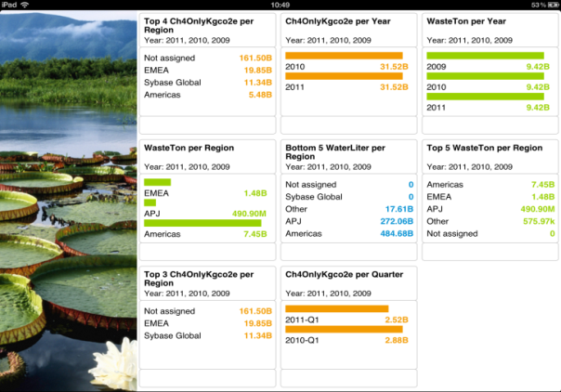

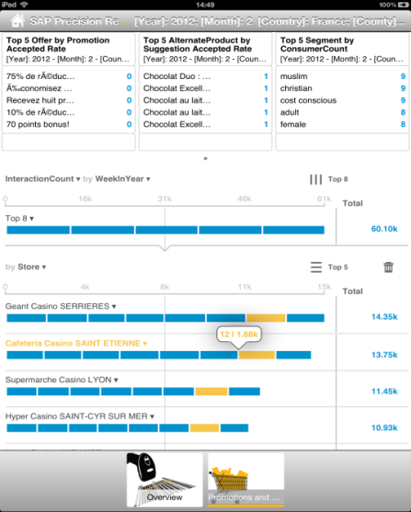
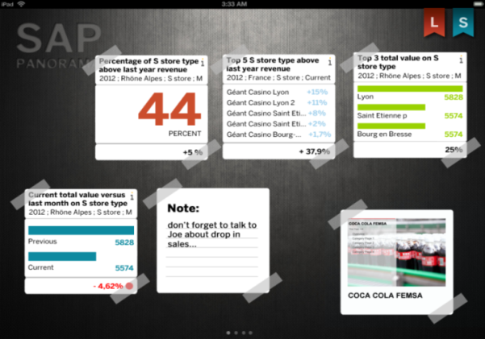


What is Panorama?
Vision: Panorama is a self-service, real-time dashboarding mobile solution for business users, leveraging LAVA design principles as self-service enabler, Analytics on Demand (AoD), HANA Views and Data Specification Language (DaSL) to easily create and consume powerful analytic computations running at HANA speed .
Key Value Proposition:
Self-service dashboarding
On device authoring
LAVA
Automated Storytelling

Slide 19
Future Roadmap
Within the context of Panorama:
Data Modeling and enrichment using external Linked Data Sources
Defining visualization vocabulary → recommendation of visualization
Machine learning problems and user profiling

Slide 20
Summary
Participation in 3 projects (RUBIX, remix and Panorama)
Project remix made it to the finals in TechEd Madrid
Published 3 papers
Investigating possible research problems in Panorama

Slide 21
Thank You!
Contact information:
Ahmad Assaf
www.ahmadassaf.com
@ahmadaassaf
SAP Research, France
Ahmad.assaf@sap.com
+33 695 436 614

